Slide 1



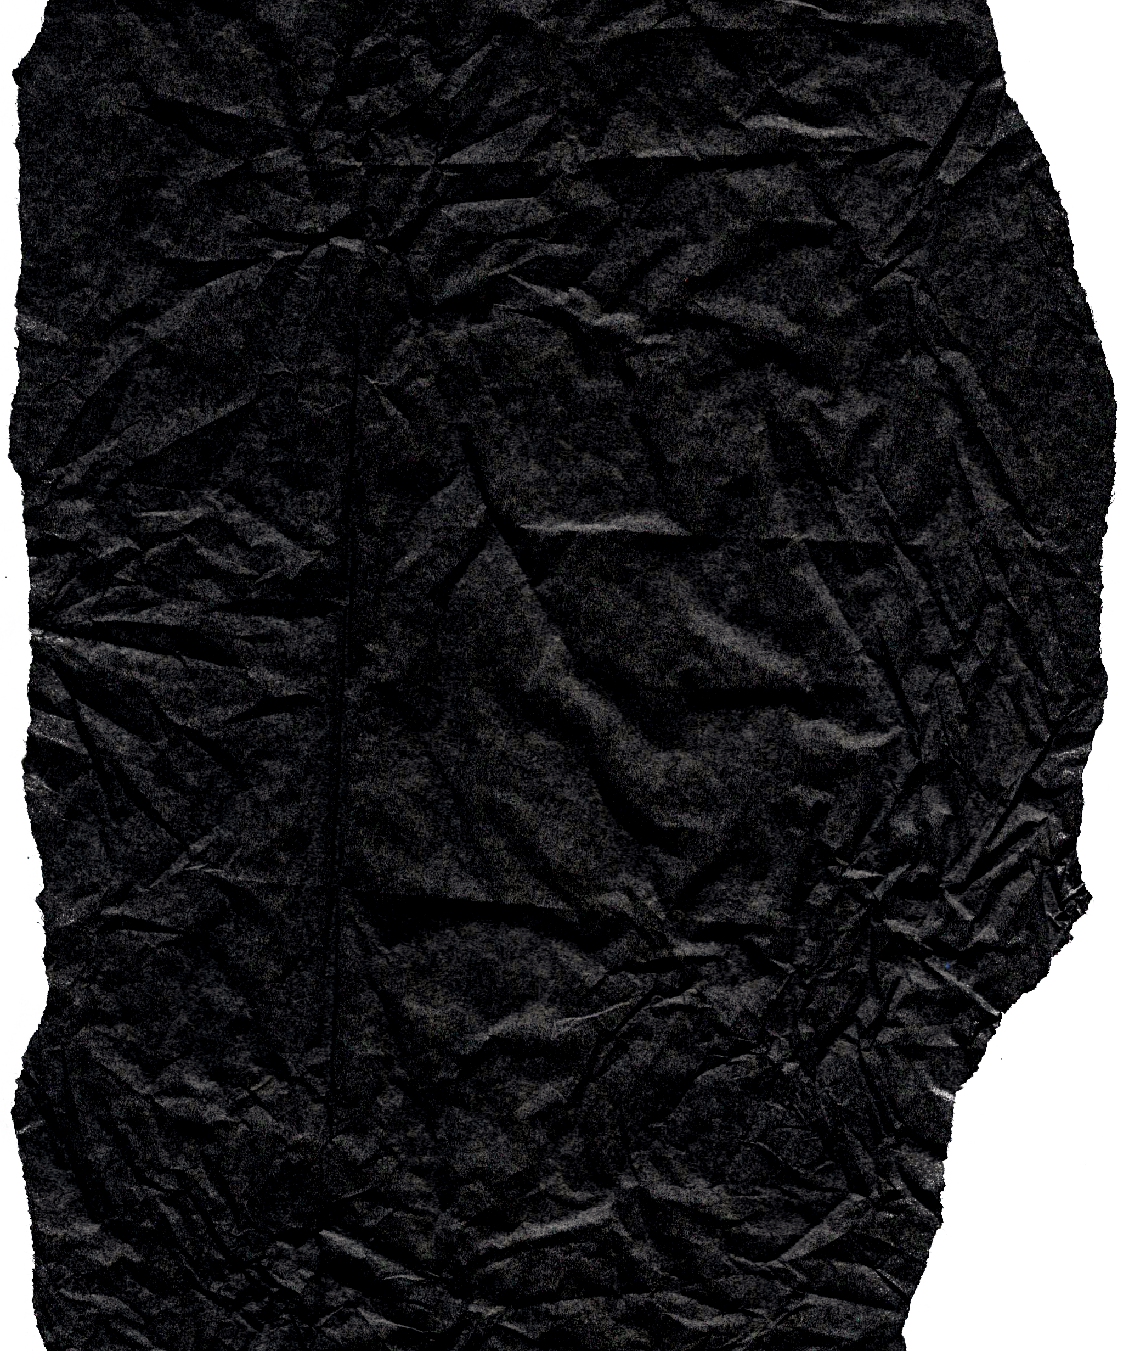




Miguel Cañete - Alexandre Antivil - Bryan Contreras

Slide 2

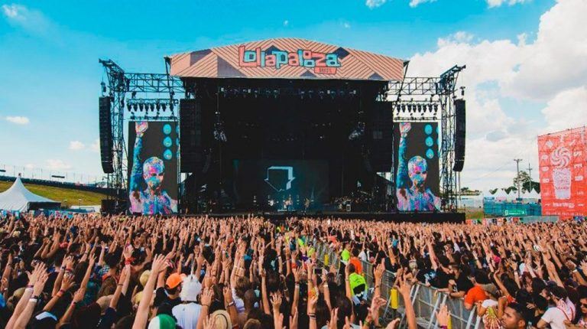
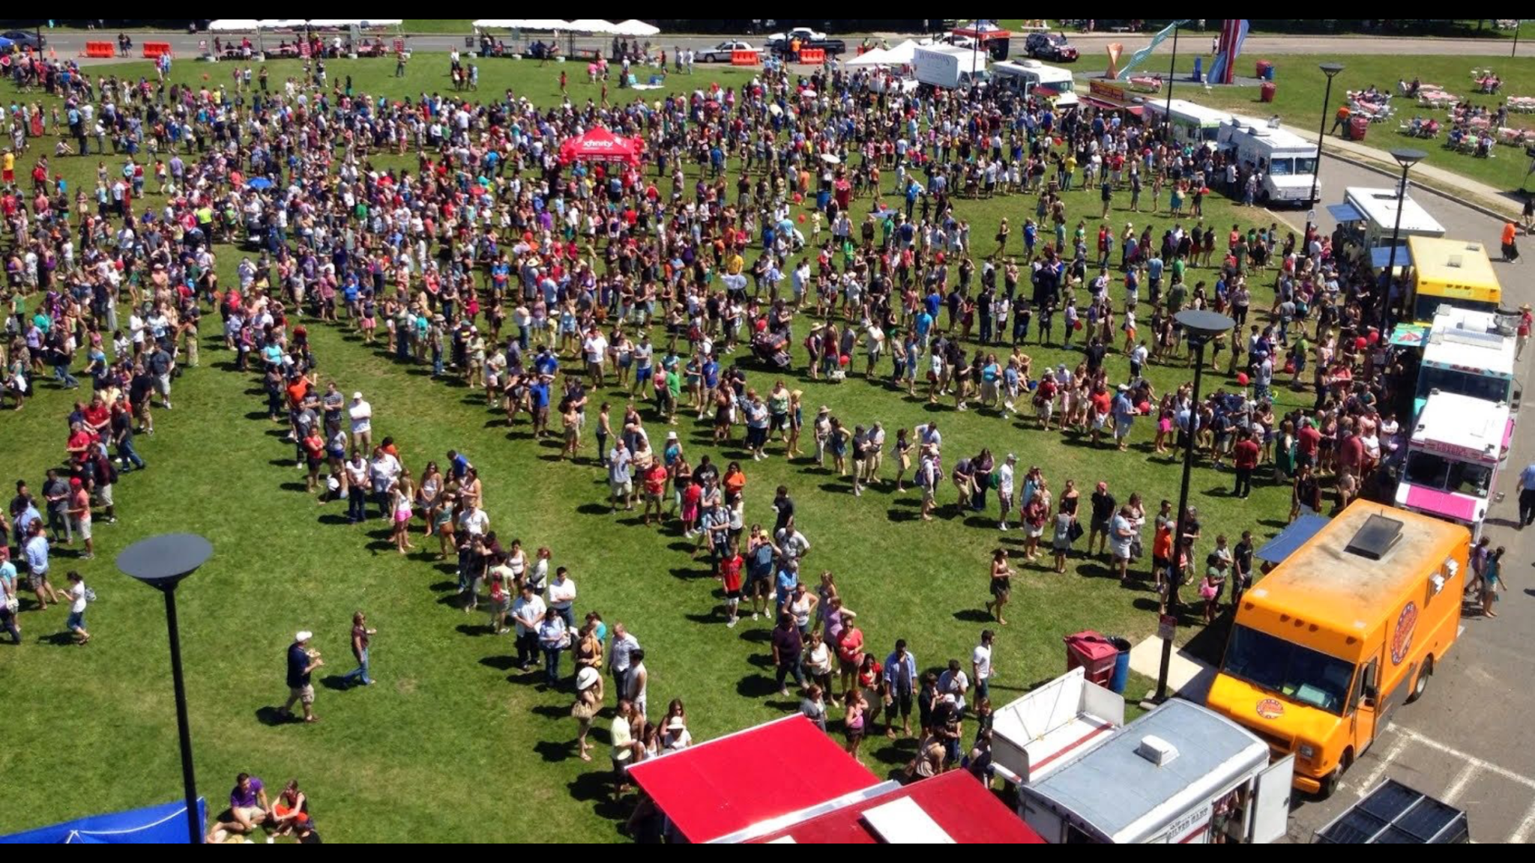


Slide 3

Miguel Cañete - Alexandre Antivil - Bryan Contreras

Slide 4
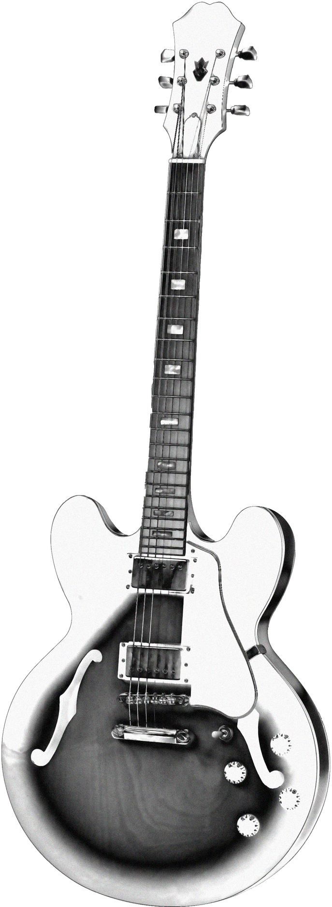

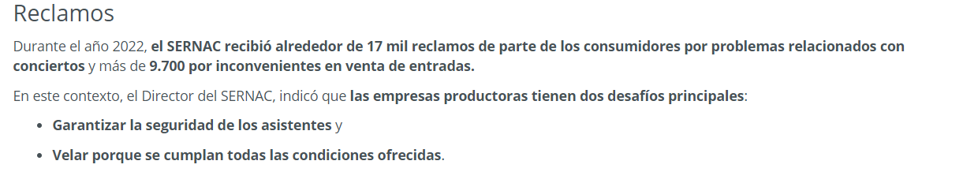

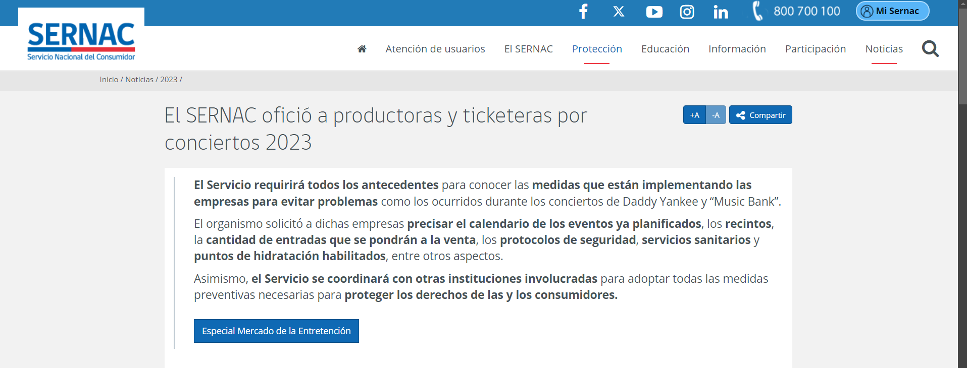

Slide 5
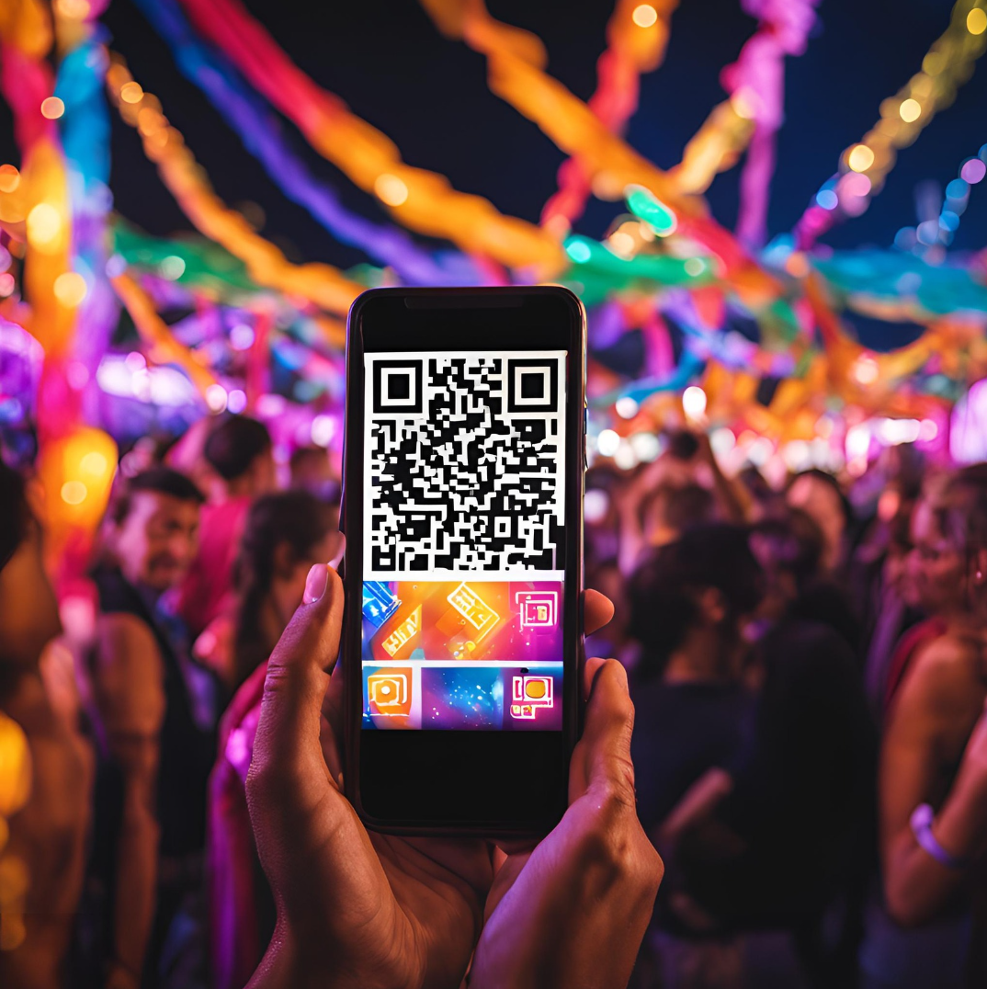

Slide 6
Methodology
Analysis: Identified pain points of attendees and vendors
Design: Developed a mobile-friendly platform with:
Menu management
Order tracking
Payment integration
Implementation: Deployed QR codes and trained vendors
Testing: Measured results and optimized system

Slide 7
Estimated Results
60% Reduction in wait times
Increased attendee satisfaction
Improved vendor efficiency and sales

Slide 8
Conclusion
Enhances event experience by eliminating food stall lines
Boosts vendor operations and profitability
Scalable and adaptable to various event types
A QR Code-Based Ordering System
Miguel Cañete - Bryan Contreras

